Slide 1

Azure DevTest Labs
Admin and Dev Working Together…….Finally
Sharon Bennett
MVP: Cloud and Datacenter Management
MCSE: Cloud Platform and Infrastructure
MCT

Slide 2
A little about me
23+ years
Infrastructure background
Instructor at LinkedIn Learning aka Lynda.com
Microsoft SMB Partner Technology Advisor
Can’t program my way out of a box
Notes:
Before we get into DevTest labs let’s get a feel for the audience.
How many of you are IT pros? And how about dev or coders?
<click>

Slide 3
Reach out!
Twitter - @bennettbusiness
LinkedIn - https://www.linkedin.com/in/sharonlbennett/

Slide 4



Challenges of running dev-test on premises
Your datacenter
IT admin
VMs in dev-test environment
Developers
Provision VMs
Request VMs
65%
of developers say it is too complicated and time-consuming to get development and test resources
Your challenges
Compromised agility
Limited hardware budget
Limited software licensing
Resource competition with VMs
Realistic scale tests often challenging
Procurement delays
10%
Average utilization of dedicated dev-test infrastructure
Source: Business Case for Test Environment Management Whitepaper, Cognizant

Slide 5
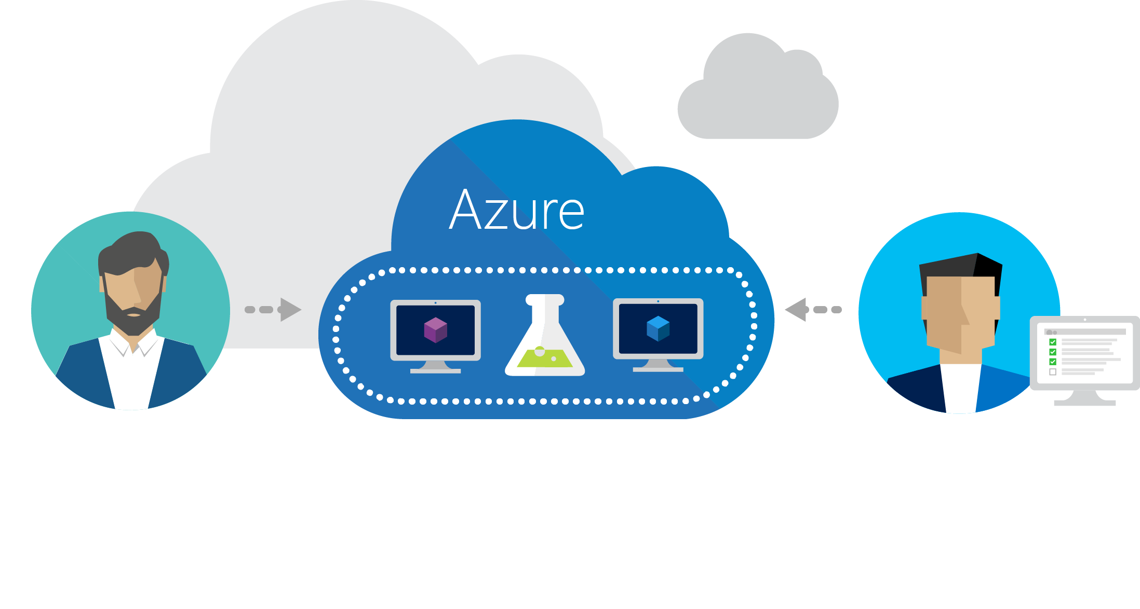
Azure DevTest Labs
Fast, easy, and lean dev-test environments in Azure.
Specifically for your team. On demand.

Slide 6
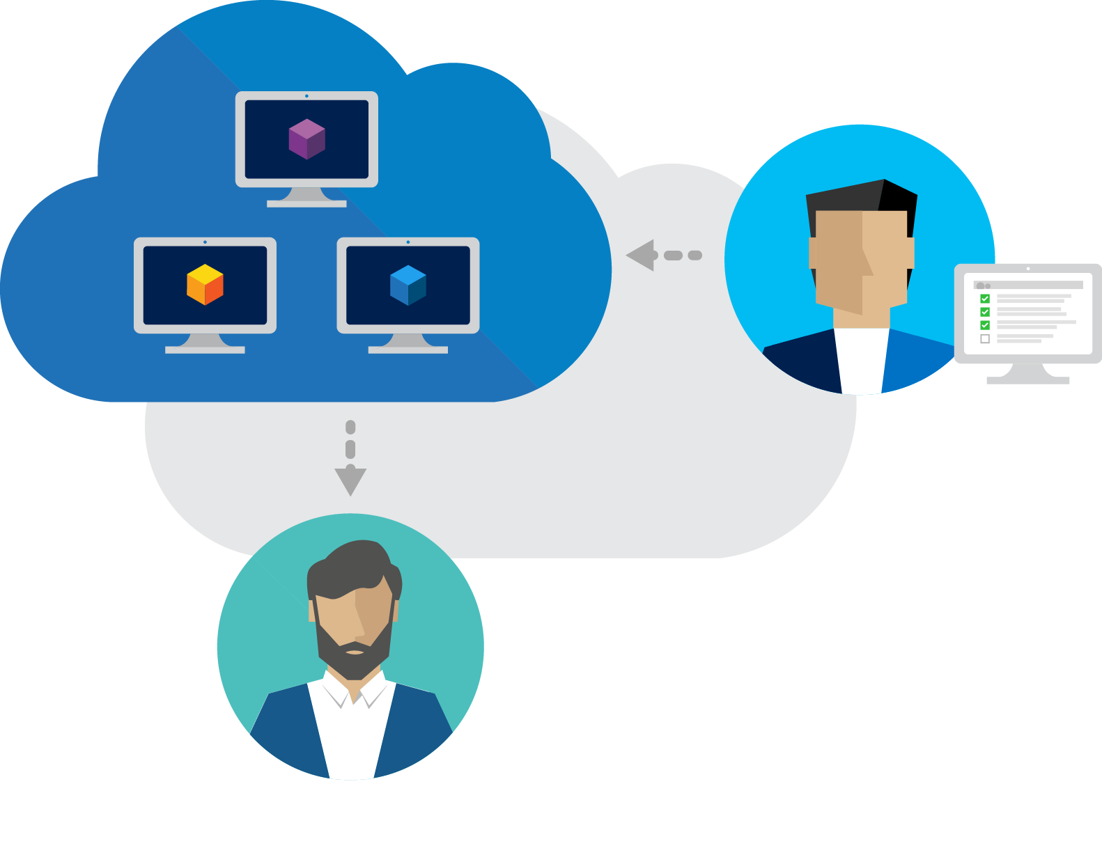
Worry-free self-service
Fast provisioning
Share Templates
Integrate with your toolchain
Notes:
Worry-free self-service
DevTest Labs makes it easier to control costs by allowing you to set policies on your lab - such as number of virtual machines (VM) per user and number of VMs per lab. DevTest Labs also enables you to create policies to automatically shut down and start VMs.
Quickly get to ready-to-test
DevTest Labs enables you to create pre-provisioned environments with everything your team needs to start developing and testing applications. Simply claim the environments where the last good build of your application is installed and get working right away. Or, use containers for even faster and leaner environment creation.
Create once, use everywhere
Capture and share environment templates and artifacts within your team or organization - all in source control - to create developer and test environments easily.
Integrates with your existing toolchain
Leverage pre-made plug-ins or our API to provision Dev/Test environments directly from your preferred continuous integration (CI) tool, integrated development environment (IDE), or automated release pipeline. You can also use our comprehensive command-line tool.

Slide 7
IT Admin Benefits
Virtual machine size
Images
Number of virtual machines user/team
Shutdown and startup
Users

Slide 8
Dev Benefits
Virtual machines already built
Artifacts included
Golden Image
Tie into VS
Tie into GitHub

Slide 9


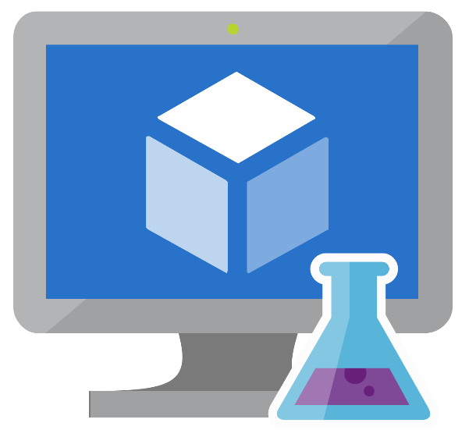

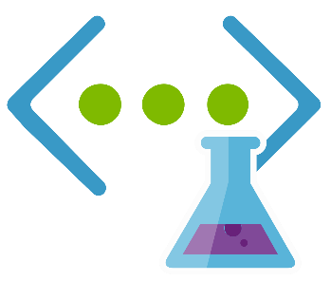
Dev Box in the Cloud
Notes:
IT create the bits and pieces, Dev initiates.
Base images are virtual machines images with all the tools an settings preinstalled and configured to quickly create a virtual machine.

Slide 10

Save a VM as a reusable image

Slide 11
Use Formula as a reusable base
Notes:
Add in artifacts into the image. No reason to add artifacts everytime.
All the parameters of the virtual machine are already handled, from the size of the virtual machine, vnet and artifacts.

Slide 12


Bring your VNET
Notes:
Bring our own DNS

Slide 13

Add/Attach additional data disks

Slide 14
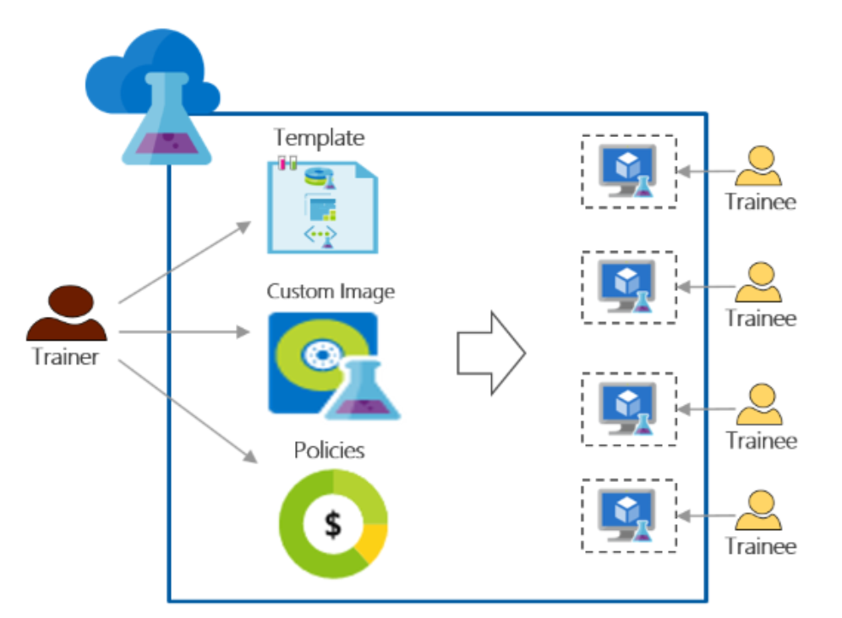
Training Scenario
Notes:
Trainees cannot see VMs created by other trainees
Every training machine should be identical
Trainees can quickly provision their training environments
Control cost by ensuring that trainees cannot get more VMs than they need for the training and also shutdown VMs when they are not using them
Easily share the training lab with each trainee
Reuse the training lab again and again

Slide 15
Demo

